Slide 1
Apache HAWQ 介绍
马丽丽
2017年10月

Slide 2
提纲
HAWQ是什么？
HAWQ总体架构
弹性执行引擎
资源管理
与Hadoop生态系统的交互
数据仓库上云探讨

Slide 3
SQL on Hadoop引擎的出现
Hadoop/HDFS
数据存储的低成本
数据高可用性,自动三备份机制
Hadoop上并行编程框架（MapReduce）的局限
使用复杂，需适应新的接口
多任务之间必须落盘 →没有必要
传统MPP并行数据库
不同节点之间高效的数据传递 → Interconnect
不同阶段之间数据在内存中存放
HDFS + MPP → HAWQ

Slide 4


Apache HAWQ是什么？
Hadoop-native SQL query engine and advanced analytics MPP database that offers high-performance interactive query execution and machine learning to Data Analysts & Data Scientists who want to find insights in large/complex datasets.
HORTONWORKS
HDB
Powered by Apache HAWQ

Slide 5






HAWQ 编年史
MADlib launched
open-source
Greenplum based on PostgreSQL
Postgres developed at UC Berkeley
Open Source PostgreSQL
HAWQ project launched
HAWQ 2.0
HAWQ 1.0
HAWQ 2.3
1995 1997 1999 2001 2003 2005 2007 2009 2011 2013 2015 2017
1986 … 1994 1996 1998 2000 2002 2004 2006 2008 2010 2012 2014 2016
PostgreSQL 7.0 released
Hadoop 2.0 Released
Postgres adds support for SQL
PostgreSQL 8.0 released
Hadoop 1.0 Released

Slide 6
提纲
HAWQ是什么？
HAWQ总体架构
弹性执行引擎
资源管理
与Hadoop生态系统的交互
数据仓库上云探讨

Slide 7





HAWQ 全局概况
Hardened, 10+ Years Investment, Production Proven
Leverage Existing SQL Skills & BI Tools
Easily Integrate with BI/Analytic Tools
Cost Based Optimizer
Discover New Relationships
Enable Data Science
Analyze External Sources
Query All Data Types
Large Scale Analytics
ANSI SQL Standard
HDFS Native File Formats
Dynamic Pipelining
MPP Architecture
Machine Learning
OLAP Extensions
Connectivity
Compression + Partitioning
ACID + Transactional
Data Federation
Language Extensions
JDBC ODBC
Connectivity
Core
Extensibility
Ambari Management
Multi-level Fault Tolerance
Online Expansion
Resource Mgmt (+ YARN)
Granular Authorization
Well Integrated with Hortonworks Data Platform
Manage Multiple Workloads
Security controls
Operations
Multi-tenancy + Security
Hadoop / HDFS

Slide 8
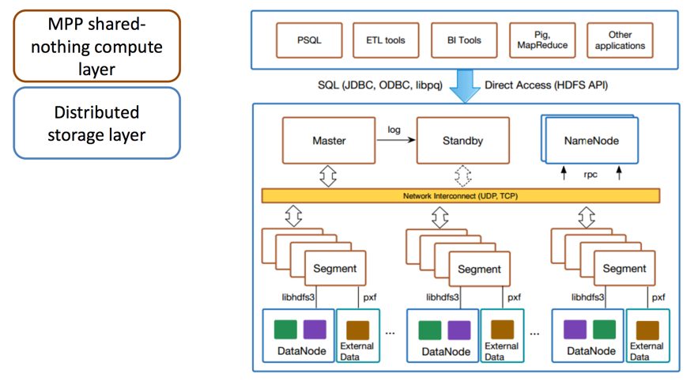
HAWQ 架构

Slide 9
内核架构
YARN
Resource Manager
Node
Manager
Node
Manager
Node
Manager
Catalog service
Container
Container
Container
Container
Container
Container
HAWQ
Master
QE
QE
QE
HAWQ
Master
QE
QE
QE
QE
QE
QE
Segment
Segment
Segment
QE
QE
QE
QE
QE
QE
QE
QE
QE
HAWQ
Master
NameNode
DataNode
DataNode
DataNode

Slide 10
Yarn
NameNode
NameNode
libYARN
Masters
Resource Broker
Optimizer
Parser/
Analyzer
Resource Manager
HDFS Catalog Cache
client
Fault Tolerance Service
Dispatcher
Catalog
Service
Virtual
Segment
Virtual
Segment
Virtual
Segment
Virtual
Segment
Virtual
Segment
Virtual
Segment
Physical Segment
Physical Segment
Physical Segment
Interconnect
Interconnect
DataNode
DataNode
DataNode
NodeManager
NodeManager
NodeManager
External System

Slide 11
HAWQ 子模块
HAWQ Master
HAWQ Standby Master
YARN RM
Postmaster
Postmaster
Query Parser
Query Optimizer
WAL replication
Query Parser
Query Optimizer
Metadata
Resource Mgr.
Metadata
Resource Mgr.
Transaction Mgr.
QE
Transaction Mgr.
QE
NameNode
Query Dispatch
Query Dispatch
Interconnect
Server 1
Server 2
….
Server N
HAWQ Segment
HAWQ Segment
HAWQ Segment
Postmaster
Postmaster
Postmaster
Virtual Segments (Query Executors)
Virtual Segments (Query Executors)
Virtual Segments (Query Executors)
libhdfs3
libhdfs3
libhdfs3
Datanode
PXF
YARN NM
Datanode
PXF
YARN NM
Datanode
PXF
YARN NM
Local directory
(Temp Data / Logs)
Local directory
(Temp Data / Logs)
….
Local directory
(Temp Data / Logs)

Slide 12
HAWQ Master
Located on a dedicated node production
Does not contain any user data
Contains Global System Catalog
System tables that contain HAWQ metadata
Authenticates client connections
Processes SQL
Distributes work between segments
Coordinates results returned by segments
Presents final client results
HAWQ Master
NN cache
Fault Tolerant Svc
Query Parser
Query Optimizer
Metadata
Resource Mgr.
Transaction Mgr.
QE
Query Dispatch
Notes:
The HAWQ master is located on dedicated node and separate node from NameNode. It Contains no user data. The HAWQ master authenticates clients and accepts client requests, processes SQL, determines the most efficient parallel query execution and converts the SQL in to parse tree data structure. Then it
Dispatches the query plan to the HAWQ segments.

Slide 13
HAWQ Segment
A HAWQ segment is an HDFS client that runs on a DataNode
Multiple Virtual Segments per Segment Host
Virtual Segments are containers for query executors
Segment is a basic unit of parallelism
Multiple segments work together to form a single parallel query processing system
Operations (scans, joins, aggregations, sorts, etc.) execute in parallel across all segments simultaneously
Server 1
HAWQ Segment
Postmaster
Virtual Segments (Query Executors)
libhdfs3
Datanode
PXF
YARN NM
Local directory
(Temp Data / Logs)
Notes:
HAWQ segments with a HAWQ Segment host are HDFS client processes on DataNodes. There may be 1, 2 or 4 HAWQ segments on a datanode depending on the Hadoop environment and cluster usage requirements. A segment is a unit of parallelism and all segments work together in tandem to form a single parallel query operation.

Slide 14
HAWQ 核心技术
HAWQ 使命
短期：将Greenplum存储放至HDFS，兼顾MPP并行数据库与HDFS存储备份的优点
长期：存储/计算分离； 存储可使用其他存储介质、上云
HAWQ 1.0
Segment无状态：数据表元信息存放主节点，文件信息存放Hadoop Namenode
Metadata Dispatch：Master将查询计划及涉及到表的元信息推至segment 计算节点
Transaction 管理： swimming lane，分布式事务退化至单节点事务处理
存储：内部表支持开源行列存储格式Parquet，方便与Hadoop生态系统兼容
HAWQ 2.0：弹性可扩展 （Virtual Segment）
存储：单表数据存储在同一目录，select任务节点数目不需等同于insert任务节点数目
弹性执行：依照查询执行负载动态计算需要执行该查询的task数目
资源管理：动态分配查询执行资源
生态圈大融和： 配置安装Ambari；资源管理 Yarn; 权限管理 Ranger；数据透明加密 TDE
可扩展存储框架：更多存储系统+更多文件格式

Slide 15
HAWQ 2.0 新功能点
Areas of Enhancement
New Features
Elastic & Scalable Architecture
Elastic Runtime for Query Execution
Per Table Directory storage (user friendly)
Hadoop-Native Integrations
Block-level Storage
New Dispatcher + Fault Tolerance Service
Performance & Optimizations
Dynamic Cluster Expansion (no redistribute)
YARN-Integrated 3-Tier Resource Mgmt
Simplified User Experience
HCatalog integration - Read Access
Cloud-Readiness
Simpler Management via Ambari and CLI
HDFS Catalog Cache

Slide 16
提纲
HAWQ是什么？
HAWQ总体架构
弹性执行引擎
资源管理
与Hadoop生态系统的交互
数据仓库上云探讨

Slide 17
弹性查询执行
Query execution is dynamic & flexible
Allows Scale-up/down
Allows Scale-in/out
Smart & efficient use of resources
More adapted to shared or cloud environments
How it works: “block level storage” and “virtual segments”
Block level storage support
AO and Parquet
Scanners read granular blocks (vs files)
More control on task granularity
Plan/Task scheduling
Choose nodes that have data close
Dispatch query to nodes with available resources
Start virtual segments on demands
Virtual
Segment
Virtual
Segment
Virtual
Segment
Blocks
Blocks
Blocks

Slide 18

虚拟Segment
Virtual Segment
Simple Query
HAWQ Master
Low # of v-segs
HAWQ Cluster
HAWQ Node
Complex Query
HAWQ Master
High # of v-segs
Query on HASH-dist Table or RQ enforced
HAWQ Master
Pre-defined # of v-segs / buckets

Slide 19
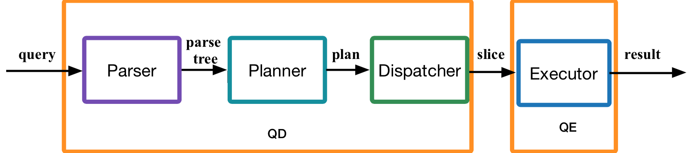
查询执行流程图
In YARN mode
YARN
containers
Resource
Manager

Slide 20
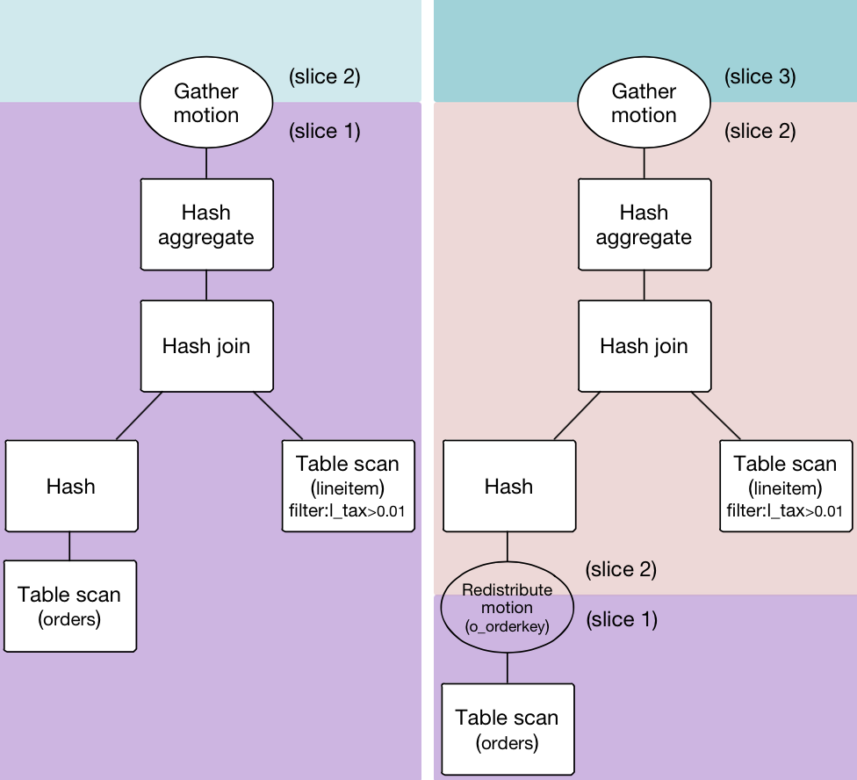
查询计划
Query Plan
Relational operators: scans, joins, etc
Parallel ‘motion’ operators
Parallel Motion Operators:
Broadcast: Every segment sends the input tuples to all other segments
Redistribution: Every segment rehashes tuples on a column and redistributes to the appropriate segments
Gather: Every segment sends the input tuples to a single segment (i.e. the master)
SELECT l_orderkey, count(l_quantity) FROM lineitem, orders
WHERE l_orderkey=o_orderkey AND l_tax>0.01
^{GROUP BY l_orderkey;}

Slide 21
查询执行示例
Select s.beer, s.price from sells as s, bars as b where s.bar = b.name and b.city = ‘San Francisco’
HAWQ Master
YARN RM
Postmaster
Query Parser
Query Optimizer
Metadata
Resource Mgr.
NameNode
Transaction Mgr.
NN Cache
Server 1
Server 2
Server N
HAWQ Segment
HAWQ Segment
HAWQ Segment
Postmaster
Postmaster
Postmaster
HDFS Datanode
HDFS Datanode
HDFS Datanode
Local directory
Local directory
Local directory

Slide 22







查询执行示例 － 计划生成
Select s.beer, s.price from sells as s, bars as b where s.bar = b.name and b.city = ‘San Francisco’
HAWQ Master
YARN RM
Postmaster
Query Parser
Query Optimizer
Metadata
Resource Mgr.
NameNode
Transaction Mgr.
NN Cache
Query Dispatch
Server 1
Server 2
Server N
HAWQ Segment
HAWQ Segment
HAWQ Segment
Postmaster
Postmaster
Postmaster
HDFS Datanode
HDFS Datanode
HDFS Datanode
Local directory
Local directory
Local directory
Notes:
SQL submitted to HAWQ master
Validates SQL and parses query
Query Optimizer produces the plan
HAWQ master obtains metadata from NameNode and annotates the query plan with metadata that segments need for execution

Slide 23
查询执行示例 － 资源申请
Select s.beer, s.price from sells as s, bars as b where s.bar = b.name and b.city = ‘San Francisco’
Server 1: 2 containers
Server 2: 1 container
Server N: 2 containers
HAWQ Master
YARN RM
Postmaster
Query Parser
Query Optimizer
Metadata
Resource Mgr.
NameNode
Transaction Mgr.
NN Cache
I need 5 containers
Each with 1 CPU core
and 1 GB RAM
Query Dispatch
Server 1
Server 2
Server N
HAWQ Segment
HAWQ Segment
HAWQ Segment
Postmaster
Postmaster
Postmaster
VS
VS
VS
VS
VS
HDFS Datanode
HDFS Datanode
HDFS Datanode
Local directory
Local directory
Local directory
VS = Virtual Segment (container for Query Executors)
# of QEs in a v-seg = # of slices in a query

Slide 24
查询执行示例 －准备执行
Select s.beer, s.price from sells as s, bars as b where s.bar = b.name and b.city = ‘San Francisco’
HAWQ Master
YARN RM
Postmaster
Query Parser
Query Optimizer
Metadata
Resource Mgr.
NameNode
Transaction Mgr.
NN Cache
Query Dispatch
Server 1
Server 2
Server N
HAWQ Segment
HAWQ Segment
HAWQ Segment
Postmaster
Postmaster
Postmaster
VS
VS
VS
VS
VS
HDFS Datanode
HDFS Datanode
HDFS Datanode
Local directory
Local directory
Local directory
VS = Virtual Segment (container for Query Executors)
# of QEs in a v-seg = # of slices in a query
Notes:
HAWQ Master dispatches the plan to every segment
Segments callback to the NameNode to obtain a block location array consisting of block IDs

Slide 25
查询执行示例 － 执行
Select s.beer, s.price from sells as s, bars as b where s.bar = b.name and b.city = ‘San Francisco’
HAWQ Master
YARN RM
Postmaster
Query Parser
Query Optimizer
Metadata
Resource Mgr.
NameNode
Transaction Mgr.
NN Cache
Query Dispatch
Server 1
Server 2
Server N
HAWQ Segment
HAWQ Segment
HAWQ Segment
Postmaster
Postmaster
Postmaster
VS
VS
VS
VS
VS
HDFS Datanode
HDFS Datanode
HDFS Datanode
Local directory
Local directory
Local directory
VS = Virtual Segment (container for Query Executors)
# of QEs in a v-seg = # of slices in a query
Notes:
Libhdfs3 read operation begins, retrieves data from DataNodes in the cluster it needs and returns data to upper level operators
Upper level operators (e.g. hash-join, hash-agg) carry on the execution using motion operators as needed

Slide 26
查询执行示例 － 结果返回
Select s.beer, s.price from sells as s, bars as b where s.bar = b.name and b.city = ‘San Francisco’
HAWQ Master
YARN RM
Postmaster
Query Parser
Query Optimizer
Metadata
Resource Mgr.
NameNode
Transaction Mgr.
NN Cache
Query Dispatch
Server 1
Server 2
Server N
HAWQ Segment
HAWQ Segment
HAWQ Segment
Postmaster
Postmaster
Postmaster
VS
VS
VS
VS
VS
HDFS Datanode
HDFS Datanode
HDFS Datanode
Local directory
Local directory
Local directory
VS = Virtual Segment (container for Query Executors)
# of QEs in a v-seg = # of slices in a query

Slide 27
查询执行示例 － 清理
Select s.beer, s.price from sells as s, bars as b where s.bar = b.name and b.city = ‘San Francisco’
HAWQ Master
YARN RM
Postmaster
OK
Query Parser
Query Optimizer
Metadata
Resource Mgr.
Free query resources
Server 1: 2 containers
Server 2: 1 container
Server N: 2 containers
NameNode
Transaction Mgr.
NN Cache
Query Dispatch
Server 1
Server 2
Server N
HAWQ Segment
HAWQ Segment
HAWQ Segment
Postmaster
Postmaster
Postmaster
VS
VS
VS
VS
VS
HDFS Datanode
HDFS Datanode
HDFS Datanode
Local directory
Local directory
Local directory
VS = Virtual Segment (container for Query Executors)
# of QEs in a v-seg = # of slices in a query

Slide 28
查询执行示例 － 清理
Select s.beer, s.price from sells as s, bars as b where s.bar = b.name and b.city = ‘San Francisco’
HAWQ Master
YARN RM
Postmaster
Query Parser
Query Optimizer
Metadata
Resource Mgr.
NameNode
Transaction Mgr.
NN Cache
Query Dispatch
Server 1
Server 2
Server N
HAWQ Segment
HAWQ Segment
HAWQ Segment
Postmaster
Postmaster
Postmaster
HDFS Datanode
HDFS Datanode
HDFS Datanode
Local directory
Local directory
Local directory

Slide 29
提纲
HAWQ是什么？
HAWQ总体架构
弹性执行引擎
资源管理
与Hadoop生态系统的交互
数据仓库上云探讨

Slide 30
分层资源管理
Global (YARN)
HAWQ (Resource Qs)
Query (Internal)
Cluster level
HAWQ Internal
Query level
Cluster-Admin defined
HAWQ-Admin defined
System defined
Hardware efficiency
Multi-tenancy
Query Optimization
Share with MR/Hive/+
Workload prioritization
Operator prioritization
Defined in XML
Defined in DDL
Dynamic

Slide 31
资源管理
职责
负责与Yarn交互申请、返回CPU和内存资源
负责HAWQ用户查询间的资源分配
Master resource manager process
与yarn进行资源协调和分配
管理维护资源池中资源
响应Dispatcher的资源申请请求，返回可用资源列表
负责不同节点间的Fault Tolerance管控
Segment resource manager process
每个物理segmnet上有个HAWQ 从节点资源管理
与master资源管理器进行资源通信，进行资源强制保证（CGroup）
Fault tolerance service: 发送心跳给master资源管理器

Slide 32
层级资源队列
pg_root
Default RQs
Branch RQs
Leaf RQs
pg_default
dept1
dept2
dept3
ceo_report
monthly_report
adhoc1
daily_batch
adhoc2
daily_report

Slide 33
创建资源队列示例
CREATE RESOURCE QUEUE name WITH (queue_attribute=value [, ... ])
where queue_attribute can be:
PARENT=’queue_name’
ACTIVE_STATEMENTS=integer
MEMORY_LIMIT_CLUSTER=percentage
CORE_LIMIT_CLUSTER=percentage
SEGMENT_RESOURCE_QUOTA=’mem:memory_units’
RESOURCE_OVERCOMMIT_FACTOR=factor
memory_units ::= {64mb|128mb|256mb|1gb|2gb}
percentage ::= integer %
Example: create resource queue test_queue_1 with (parent='pg_root', memory_limit_cluster=50%, core_limit_cluster=50%);

Slide 34
YARN
NameNode
libYARN
Resource Broker
Parser/ Analyzer
HDFS Catalog Cache
Client
Resource Manager
Optimizer
Client
Fault Tolerance Service
Dispatcher
Catalog Service
Client
Virtual Segment
Virtual Segment
Virtual Segment
Virtual Segment
Virtual Segment
Virtual Segment
Virtual Segment
Virtual Segment
Virtual Segment
Virtual Segment
Virtual Segment
Virtual Segment
Segment
Segment
Segment
YARN
Node Manager
YARN
Node Manager
YARN
Node Manager
HDFS DataNode
HDFS DataNode
HDFS DataNode
External System

Slide 35
资源管理器与Yarn的交互
YARN Resource Manager
register/unregister
allocate/release resource
get cluster/container reports
get queue information
resource track and schedule
LibYarn
HAWQ Resource Manager
(Application Master)
Yarn Node Manager
active

Slide 36
提纲
HAWQ是什么？
HAWQ总体架构
弹性执行引擎
资源管理
与Hadoop生态系统的交互
数据仓库上云探讨

Slide 37
与Hadoop生态系统交互
存储
HDFS Catalog Cache vs. Libhdfs3
Parquet
PXF
InputFormat/OutputFormat
Hawq extract/register
资源管理
LibYarn
用户权限认证
Ranger
透明数据加密
TDE

Slide 38
数据访问层集成
HDFS 元数据 - 缓存
HAWQ 元数据:
Catalog Table -> schema & hdfs file name
HDFS NameNode -> Block information for each hdfs file
HAWQ master connects to HDFS Namenode to fetch block information of HDFS files
The block information may be huge for large table -> performance downgrade if fetching every time
HDFS Catalog Cache → Store previous block information & LRU Replacement Policy
HDFS 数据 -- Libhdfs3 协议
How to access data in HAWQ(C) from HDFS (Java)?
Libhdfs
JNI based C language library
Users must deploy HDFS jars on every machine to use it
Libhdfs3
native Hadoop RPC protocol and HDFS data transfer protocol
lightweight, small memory footprints
Easy to use and deploy

Slide 39
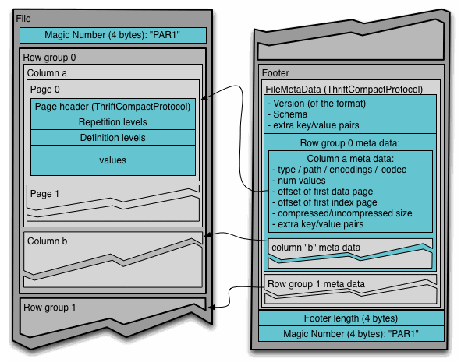
存储格式集成-Parquet
HAWQ 为 Parquet的专属定制版
不改变开源格式任何内容
新数据插入时直接append到原有文件并添加footer
目标workload是批量写
DDL
create table a(a int, b int)with(appendonly=true, orientation=parquet, compresstype=snappy);

Slide 40



外部数据源集成-PXF
Java/Thrift
Apache Tomcat
External Tables
Java API
REST API
HTTP, port: 51200
PXF Webapp
Java API
libhdfs3 (written in C) segments
Native Tables

Slide 41
数据访问格式集成 - Input / OutputFormat
Purpose
HAWQ can work align with other products in Hadoop eco-system
HAWQInputFormat
Easy for others to read data generated in HAWQ
Get key as Void type, value as HAWQRecord type -> get each hawq record in HAWQRecord struct -> record.getInt(index)
Supports both AO table and Parquet table
HAWQParquetOutputFormat
Extension to ParquetOutputFormat, specifying type to be HAWQRecord
Provides an interface setHAWQSchema for others to specify HAWQ schema
Other system can generate HAWQRecord, and thus can write the data

Slide 42
数据导入、导出- HAWQ Extract / Register
HAWQ Extract
Extract out metadata & HDFS file location for the table to yaml configuration file
Yaml configuration can be used by HAWQInputFormat
Usage hawq extract [-h hostname] [-p port] [-U username] [-d database] [-o output_file] [-W] <tablename>
HAWQ Register
Register existing files on HDFS directly to HAWQ internal table
Scenario
Register other systems generated data
HAWQ cluster migration
Usage
hawq register [-h <hostname>] [-p <port>] [-U <username>] -d <databasename> -f <hdfspath> <tablename>
hawq register [-h <hostname>] [-p <port>] [-U <username>] -d <databasename> -c <configFile> <tablename>

Slide 43
权限管理集成 - Apache Ranger
Ranger: A Global User Authorization Tool in Hadoop eco-system
Can support multiple systems such as HDFS, Hive, HBase, Knox, etc.
Provides a central UI for user to defining policies for different systems
Provide a base Java Plugin thus feasible for other products to define its own plugin to be controlled by Ranger
HAWQ Current ACL
Implement through Grant/Revoke SQL Command
Current ACL is controlled by catalog table, which is stored in HAWQ master
HAWQ needs to keep align with hadoop eco-systems, so we need integrate with Ranger ACL
Provide a GUC specifying whether enable ranger as ACL check
Once ranger is configured, move all the ACL check to Ranger side
Define all the policies in Ranger

Slide 44
HAWQ Ranger 集成实现
Create user in LDAP Server
LDAP Server
User synced to HAWQ
User synced to Ranger
HAWQ
Send ACL Check request
Ranger REST Service
Ranger Admin Server
Policy sync
active
HAWQ Ranger Plugin
Ranger Policy DB

Slide 45
数据安全性集成 - TDE(Transparent Data Encryption) Support
TDE: HDFS implements transparent, end-to-end encryption
Data is transparently encrypted and decrypted without requiring changes to user application code
Data can only be encrypted and decrypted by the client
HDFS never stores or has access to unencrypted data or unencrypted data encryption keys
HAWQ Enhancement
Modify libhdfs3 to add support for TDE

Slide 46
存储格式 - Parquet 2.0 Support
Parquet 2.0 Enhancement
Add more Converted Type: Enum, Decimal, Date, Timstamp
Add more statistics in DataPageHeader: including max/min/null count, distinct count
Add Dictionary Page
Add sorting column information in Rowgroup meta
…
HAWQ Upgrade to Parquet 2.0 support
Bring performance improvement by leveraging statistics information
Become more compatible with other systems which have supported Parquet 2.0

Slide 47
提纲
HAWQ是什么？
HAWQ总体架构
弹性执行引擎
资源管理
与Hadoop生态系统的交互
数据仓库上云探讨

Slide 48
数据仓库上云探讨和尝试
存储、计算解耦
存储放至云存储
计算节点加Cache机制，提前load云存储中数据 （Tachyon/Alluxio）
计算、计算解耦
核心计算和文本分析分离 -- GPText
核心计算和科学计算分离 -- PL Container
服务无状态
抽取Catalog Service
多Master节点，防止单点失效
查询中间执行结果可定制
Pipeline
阶段化

Slide 49
谢谢

